Slide 1
Market failure
Why market fails?
What role government has in these situations?

Slide 2

Market Failure
When a market left to itself does not allocate resources efficiently.
or
the condition where the allocation of goods and services by a market is not efficient is called Market failure.

Slide 3
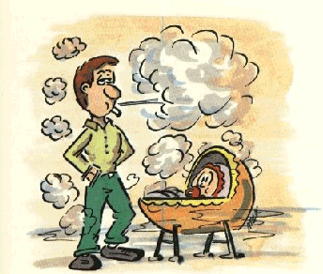
What is an Externalities
Activities and conditions whose benefits (called external economies) and costs (called external diseconomies) are not reflected in the market price of goods and services.
The primary feature of externalities is that one entity's action directly or indirectly changes the options available to other entities.

Slide 4
Four main sorts of market failure
The abuse of MARKET POWER, which can occur whenever a single buyer or seller can exert significant influence over PRICES or OUTPUT (see MONOPOLY and MONOPSONY).
EXTERNALITIES – when the market does not take into account the impact of an economic activity on outsiders. For example, the market may ignore the costs imposed on outsiders by a firm polluting the environment.
PUBLIC GOODS, such as national defense. How much defense would be provided if it were left to the market?
Where there is incomplete or ASYMMETRIC INFORMATION or uncertainty.

Slide 5

Features of Public Goods
Nonrivalrous
Nonexcludable

Slide 6

MARKET GOVERNMENT GOVERNMENT
FAILURE INTERVENTION FAILURE
EXTERNALITY PUBLIC ENTERPRISE ADMINISTRATIVE
-PUBLIC GOODS-NATIONALIZATION COST
MARKET -PRIVATIZATION COMPLIANCE
POWER REGULATION COST
INEQUITIES - OUTPUT EFFICIENCY COST
DYNAMIC - PRICE - NEGATIVE EXTER.
MKT. FAIL. - STANDARDS -PUBLIC BADS
INDIVISIBILITY ANTITRUST - MKT POWER
INFORMATION -STRUCTURE - INEQUITIES
ASYMMETRY -CONDUCT - DYNAMIC
TAXES (SUBSIDIES) - INDIVISIBILITY
PROVISION OF - INFORMATION
INFORMATION
RATIONING (MONEY)
Learning, Leadership and Service in the Jesuit Tradition
Slide 1

Slide 7
Market disequilibrium
The state of the market that exists when the opposing market forces of demand and supply do achieve a balance and there is an inherent tendency for change.
Market disequilibrium results if the market is not in equilibrium.
More specifically, market disequilibrium results if the demand price is not equal to the supply price and the quantity demanded is not equal to the quantity supplied.

Slide 8
Market disequilibrium due to Shortage
A shortage exists if the quantity demanded exceeds the quantity supplied at the current market price.
This condition emerges if the market price is below the equilibrium price.
With a market shortage, buyers are unable to buy as much of the good as they would like at the current price.
As such, they are motivated to raise the price.

Slide 9
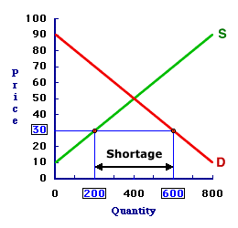
Market disequilibrium due to Shortage

Slide 10
Market disequilibrium due to surplus
A surplus exists if the quantity supplied exceeds the quantity demanded at the current market price.
This condition emerges if the market price is above the equilibrium price.
With a market surplus, sellers are unable to sell as much of the good as they would like at the current price. As such, they are motivated to lower the price.

Slide 11
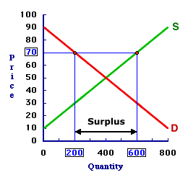
Market disequilibrium due to surplus

